Slide 1


Slide 2
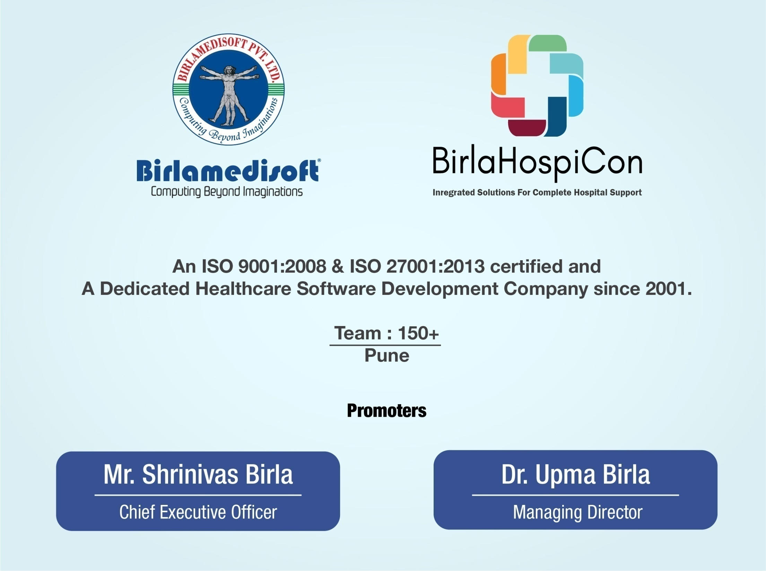

Slide 3


Slide 4
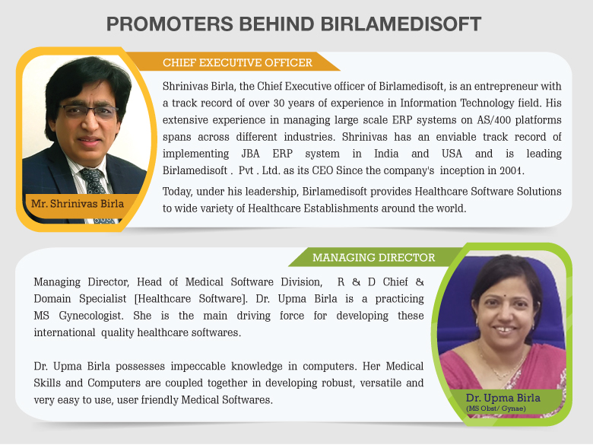

www.birlamedisoft.com

Slide 5


Slide 6


BIRLAMEDISOFT ACHIEVEMENTS AT A GLANCE
10,5000+
25,000+
5 million+
20+
Records
handling
Countries
presence
Clients
Beds

Slide 7


Vision: To make Software that is usable, comprehensible and affordable to the most
ordinary healthcare professional, running a small to big practice anywhere in the World.
Mission: To make Birlamedisoft a ubiquitous Healthcare software brand that is synonymous with the best in Quality and the most Useful of Healthcare software programs
Clients: More than 10500+ small to big satisfied clients spread across India and Abroad.
Experience: More than 18+ years of Rigorous Healthcare Software development, Healthcare Consulting, Constant Market research, and Inputs from Healthcare professionals and experts.

Slide 8
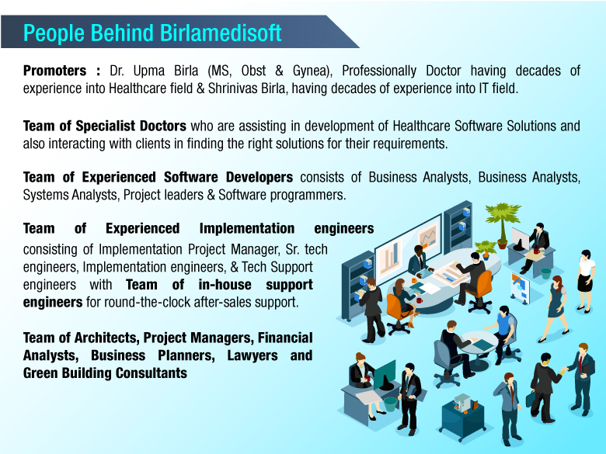

www.birlamedisoft.com

Slide 9
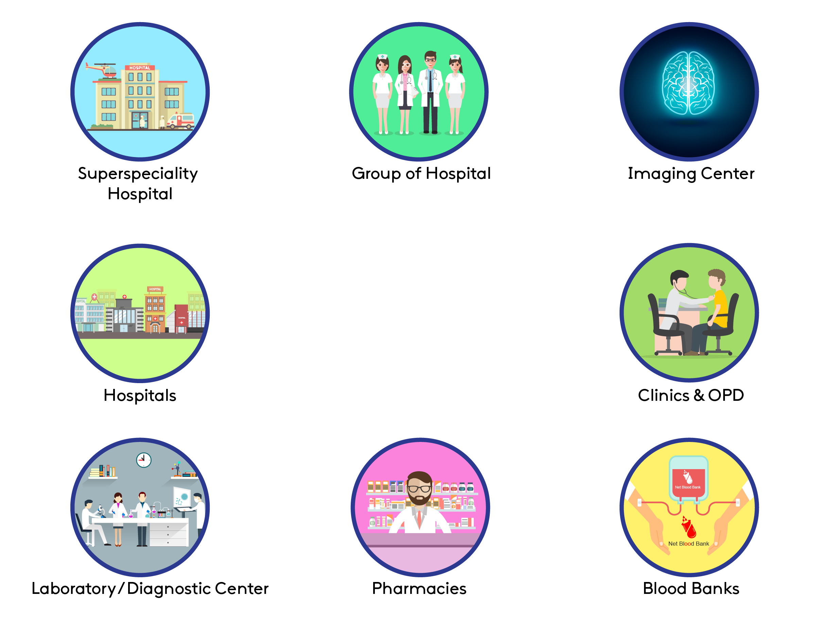
Birlamedisoft's
healthcare solutions for:

Slide 10

Birlamedisoft Medical Product Range
Super Speciality Hospital Information Management System. (HIMS)
Small Hospital Management
Blood Bank Management System
Diagnostics Management System
Lab Management System
Radiology Management System
Pharmacy Management System
Clinic Management
Drug Interaction management
OPD Management
IPD Management
Histopathology Management
Gyneacology & Pediatrics management
Ophthalmology Management
Dentistry Management
Polyclinic Management

Slide 11
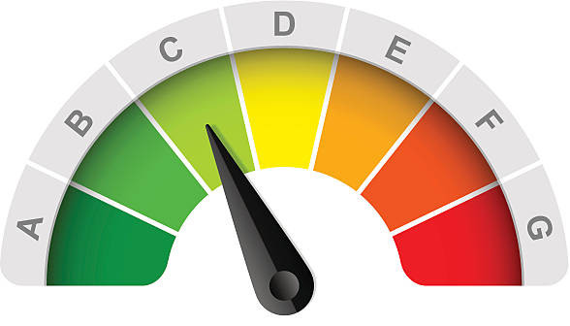





Objectives of Hospital Computerization
Improves efficiency
Reducing Cost
Information on one touch
Less Paper Work
Access information anywhere anytime
Digitally connected healthcare network

Slide 12

Current Healthcare Scenario

Slide 13
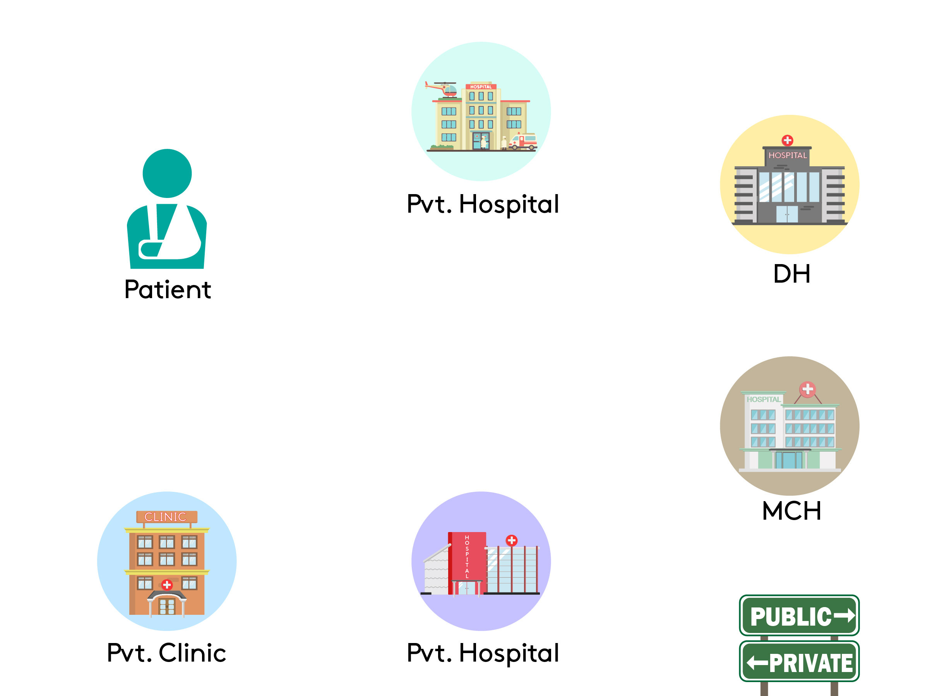
Hospital Network Functioning

Slide 14

Future Healthcare Scenario via Quanta V4.0

Slide 15
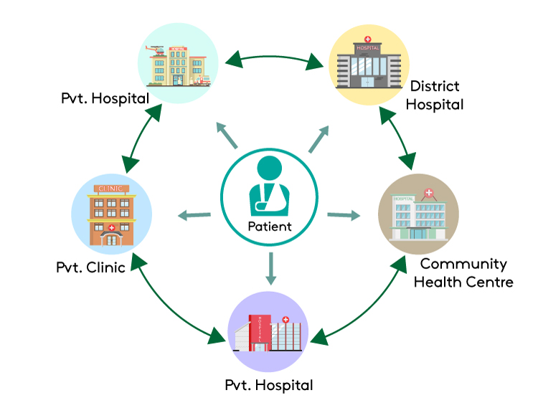

Slide 16


All this is possible by implementing Quanta V4.0 HIS in Pocket Healthcare system by Birlamedisoft

Slide 17


Slide 18


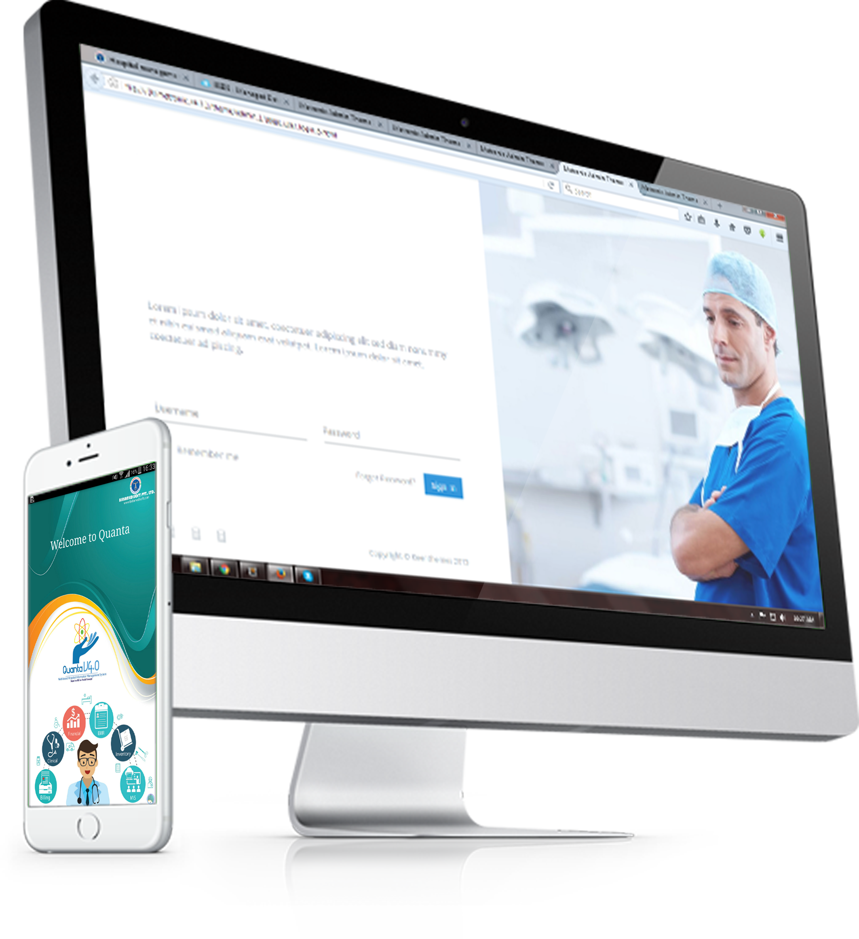
Birlamedisoft Presents
Quanta V4.0 HIS in pocket
A complete hospital management software using mobile apps.
Mobile applications for doctors, nurses, CEO, CFO, patients, pharmacy and many more to come ….

Slide 19
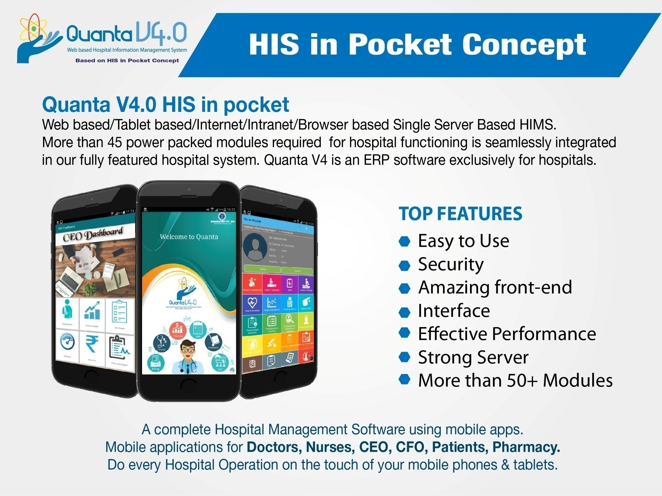

Slide 20
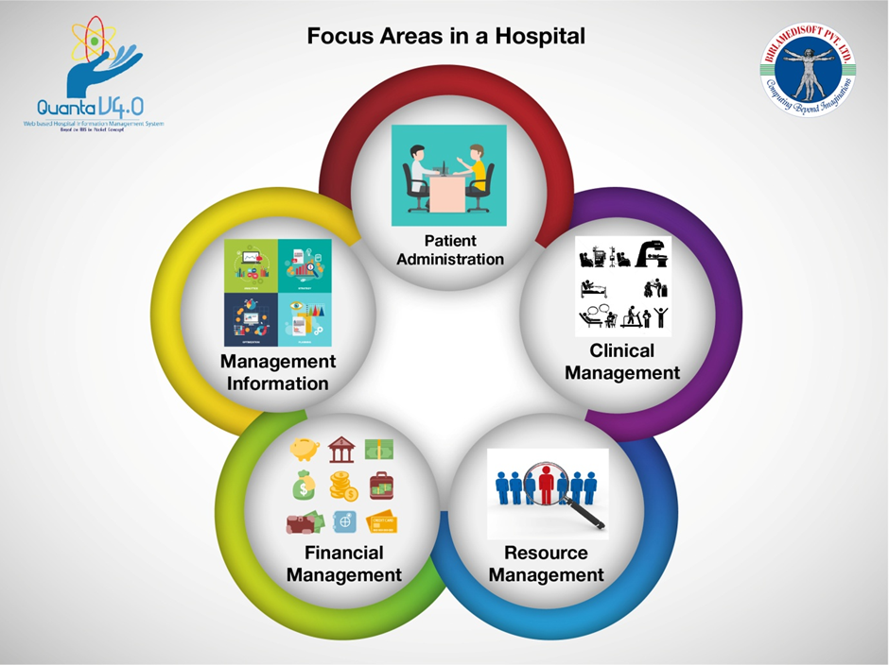

Slide 21
Quanta HIMS V4.0 All Modules
PATIENT REGISTRATION
WARD / ROOM MANAGEMENT
EMERGENCY/ CASUALTY
DOCTORS WORKBENCH
IPD PATIENT MODULE
LABORATORY INFORMATION SYSTEM
RADIOLOGY INFORMATION SYSTEM
OPERATION THEATER MANAGEMENT
CERTIFICATES ISSUE
ROSTER MODULE
COMMUNICATION MODULE
INVENTORY & FIXED ASSET
MEDICAL STORE MANAGEMENT
WARD PHARMACY/ INVENTORY MANAGEMENT
PHYSIOTHERAPY MODULE
DIET MODULE
HOUSE KEEPING MODULE
PAY ROLL MODULE
FINANCIAL ACCOUNTING MODULE
DENTAL MODULE
BLOOD BANK
MEDICAL RESEARCH
ICD – 10 DIAGNOSIS MODULE
DONATION MODULE
BILLING MODULE
AMBULANCE MODULE
USER MANAGEMENT
ADDRESS DIRECTORY
BACKUP/ RESTORE MODULE
MIS REPORTS
EQUIPMENT MAINTENANCE
CENTRAL STERILIZED SUPPLY DEPARTMENT
ENERGY AUDIT
COSTING
LIBRARY MANAGEMENT
BUDGETS
HELP DESK
FACILITY MANAGEMENT
WASTE MANAGEMENT
PACS & TELE RADIOLOGY
KITCHEN
EMR MODULE
www.birlamedisoft.com

Slide 22
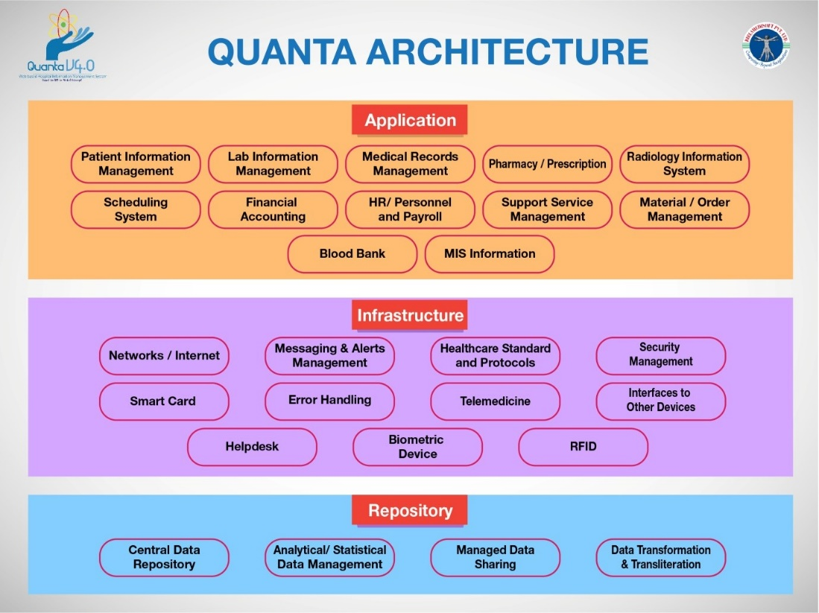

Slide 23


Categorized Classification of Modules
Modules:
Appointment Scheduling
Outpatient Management
Inpatient Management
Consultation
Registration / Master Patient Index
Accident & Emergency
Insurance
Housekeeping & Linen Management
Billing –OP/IP
Order Entry & Result Reporting
Clinician’s Access
Medical Records
Notes Tracking
Modules:
Pharmacy Management with Stock Control
Dietary
Nursing Management
Ambulatory Management
Specialty Clinic Room Management

Slide 24


Modules:
Laboratory Information System
Radiology Information System/ Imaging
Histopathology
CSSD
Operation Theatre Management
Blood bank
ICCU / ICU
General Electronic Medical Records
Modules:
Finance Management
Inventory Management
Doctors Accounting
Budgeting and planning
Costing
Asset & Equipment management

Slide 25


Modules:
Materials Management
Stores & Procurement Management
Human Resources Management
Customer Relationship Management
Kitchen Management
Linen Management
House Keeping
Asset Management
Emergency Services
Modules:
Administrative statistics
Case Mix Management
Resource utilization reports
Clinical statistics
Decision Support System
Financial Analysis

Slide 26
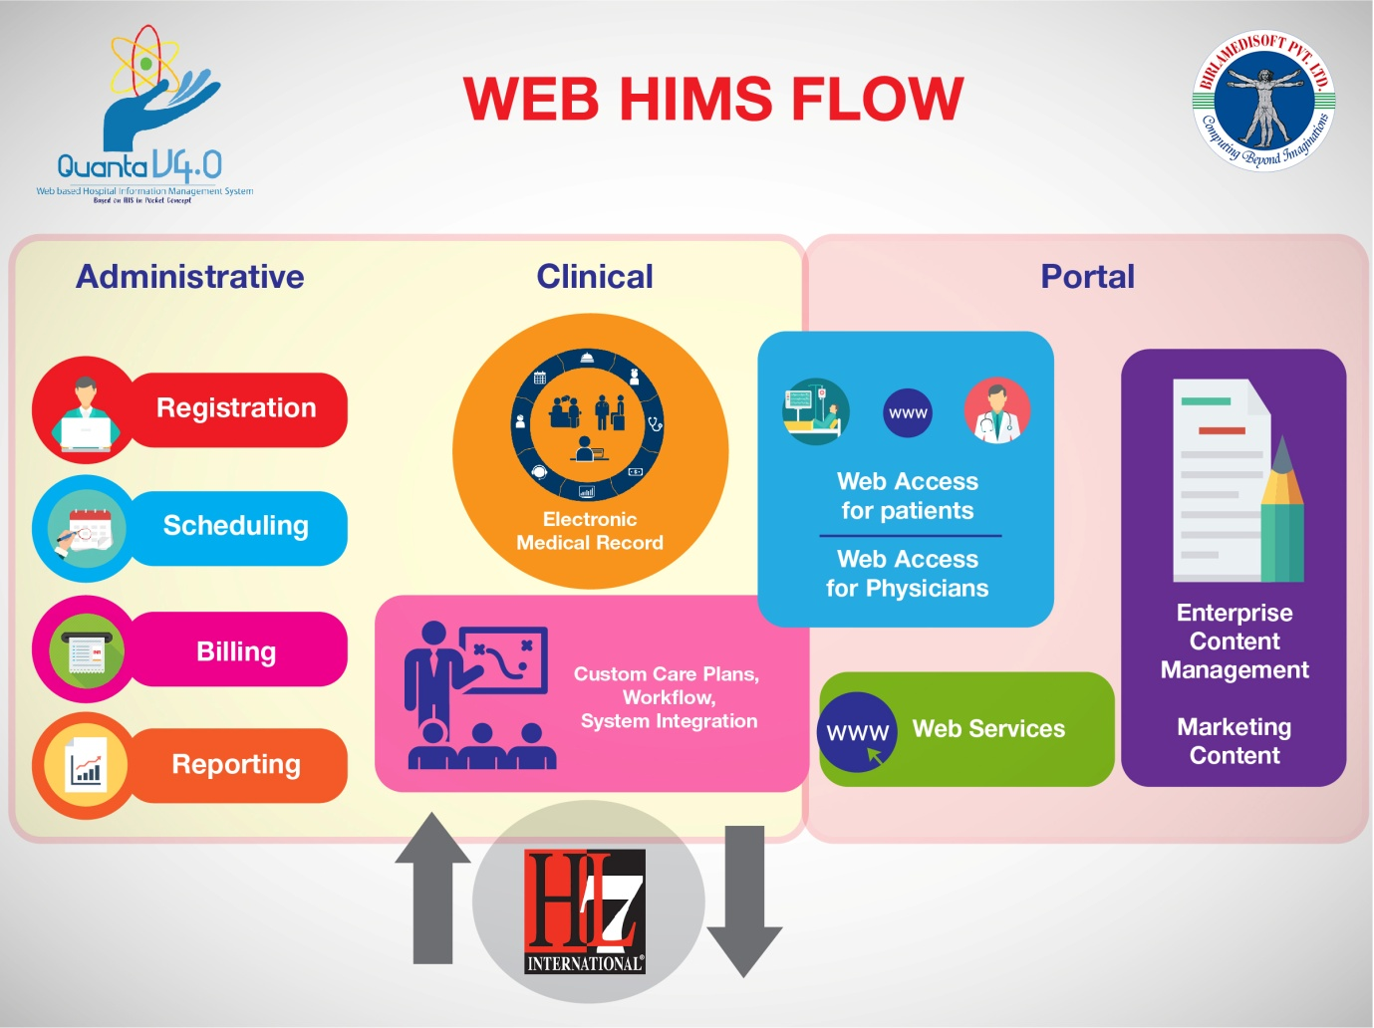

Slide 27
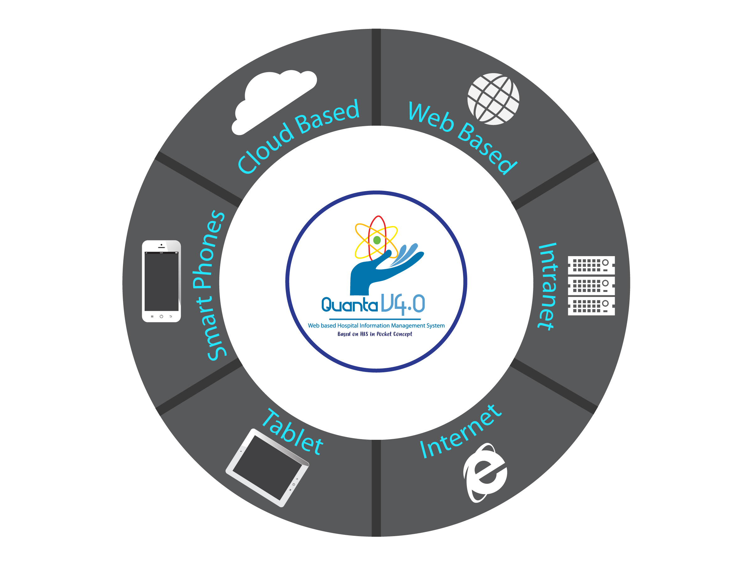
Quanta V4.0 is based on
all technologies

Slide 28

What methodologies are we using?

Slide 29
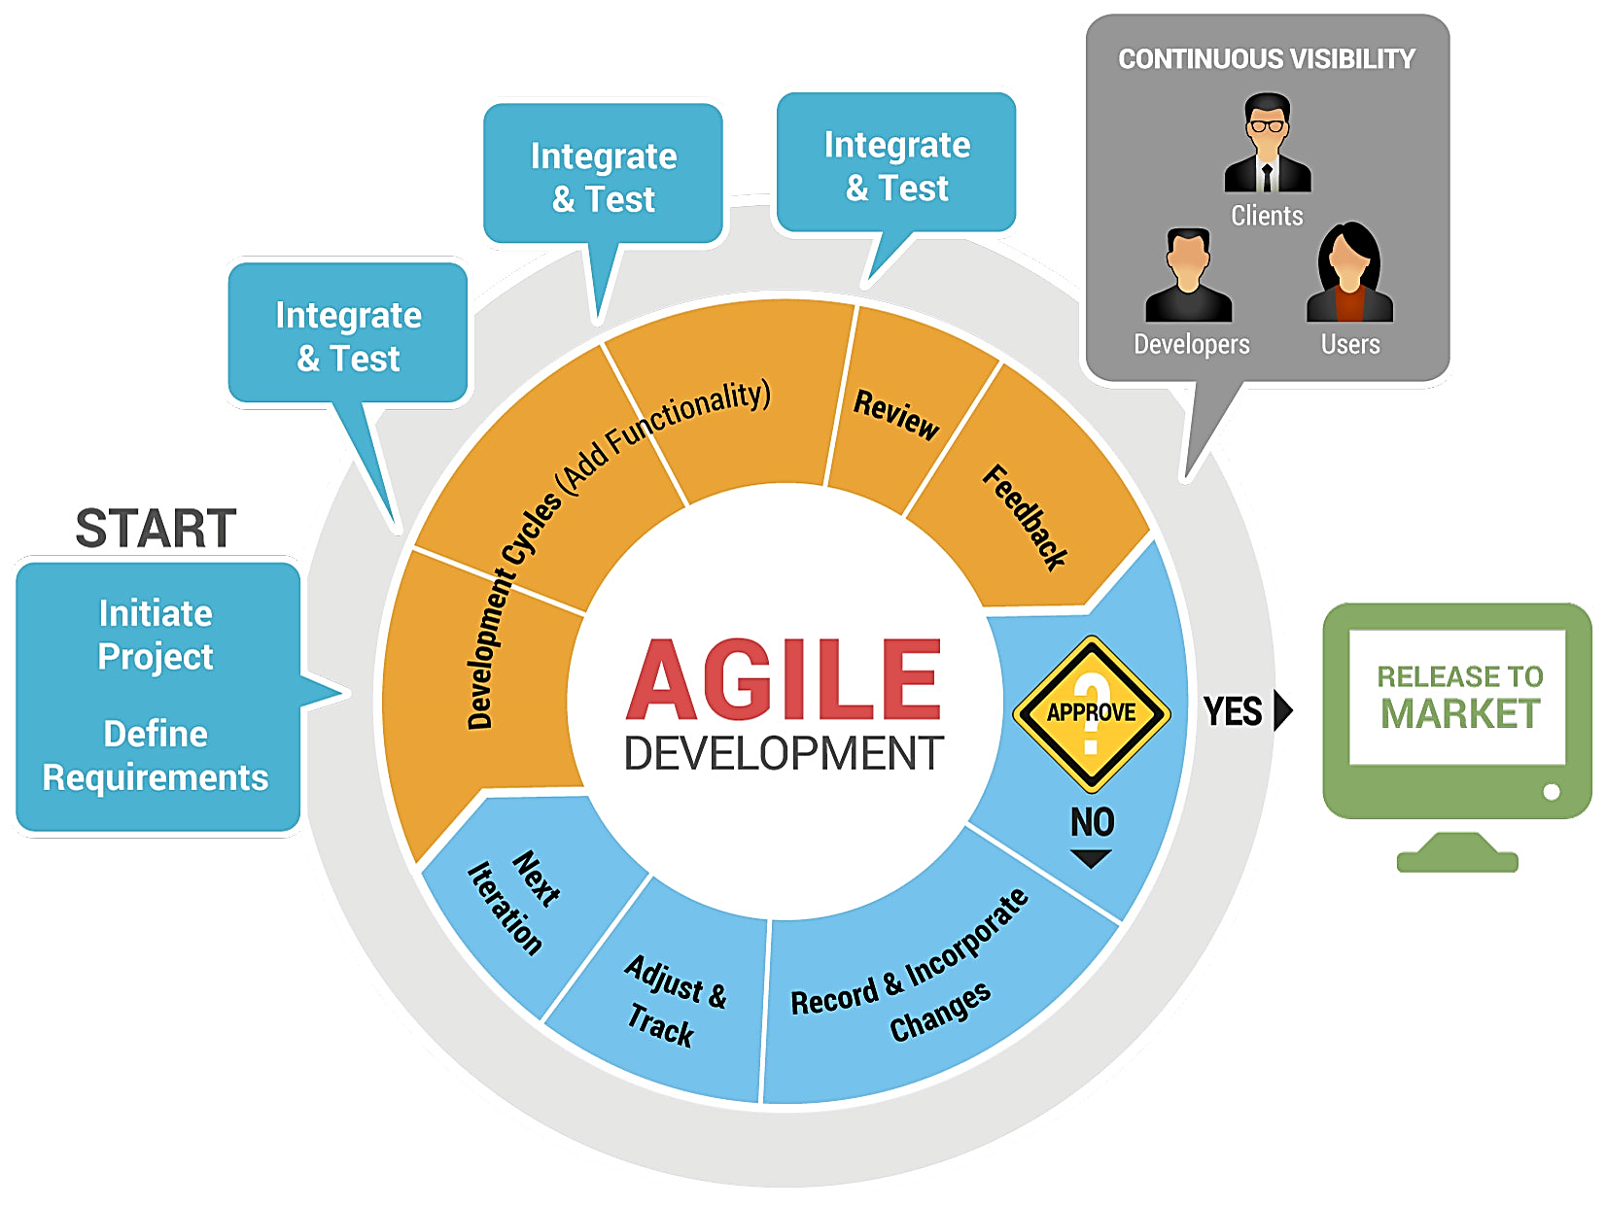

Slide 30


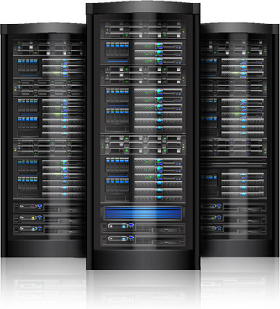
How the Hospitals are connected by Quanta
Quanta Local
Server A
Centralized Quanta Server Distributed Computing
Quanta Local
Server B
Quanta Local
Server C
Quanta Local
Server E
Quanta Local
Server D
Quanta Central server at Main Hospital Building and Quanta Local Server at every Hospital / CHC location

Slide 31
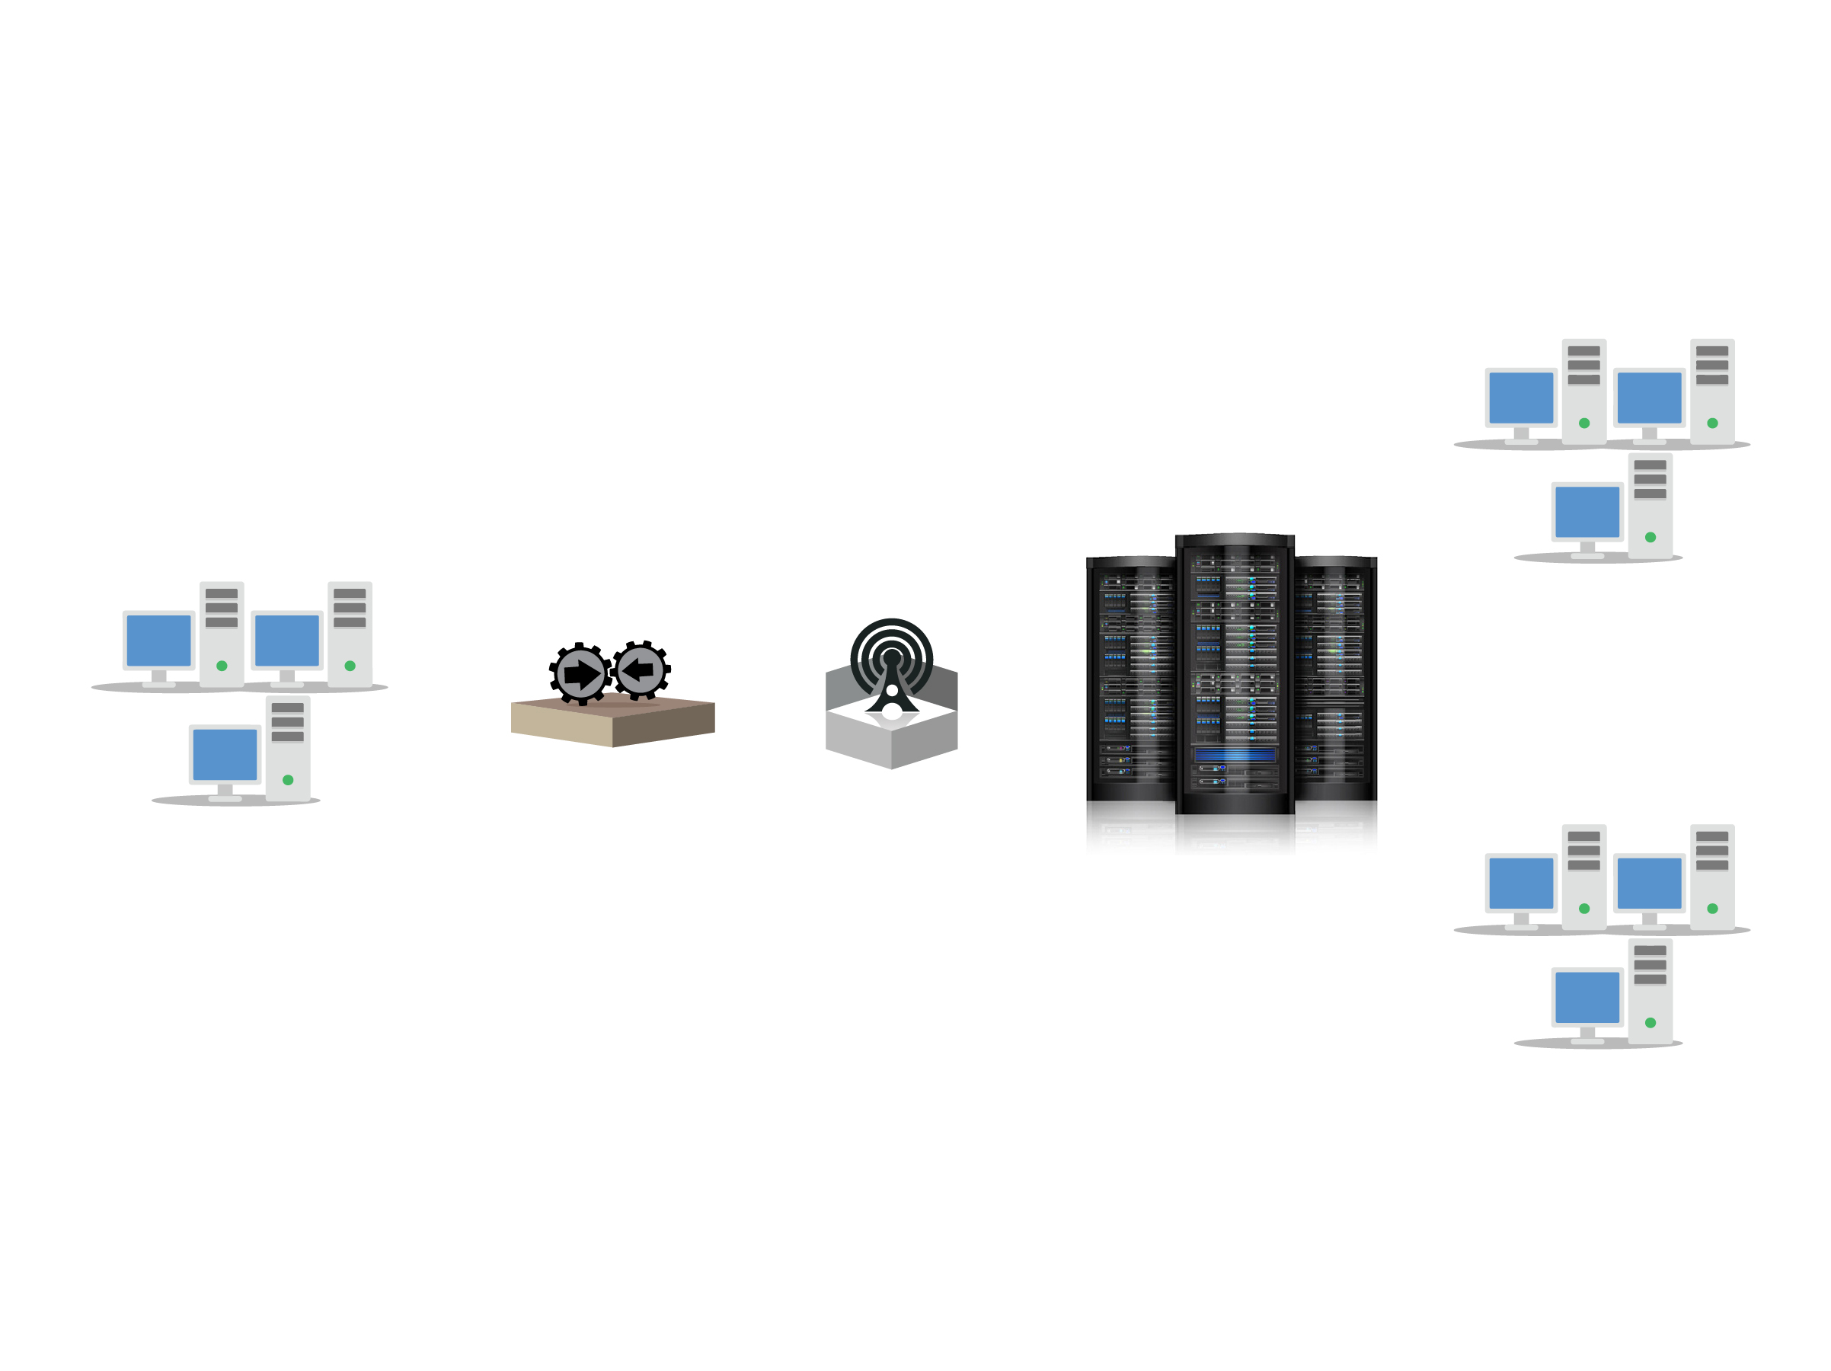
Quanta Integration within Hospital
Quanta Integration Architecture
HL messaging
Web Services
Third party software/ clients(if any)
Quanta Server
Communication layer
Public Patient
Web Based
Integration
layer
Intranet
Messaging Protocols:
FTP,HTTP,TCP/IP,other
With/without HL7 support,
customization
Client
Quanta Server running on windows platform. tier architecture, SQL Server 2008/Oracle backend.

Slide 32
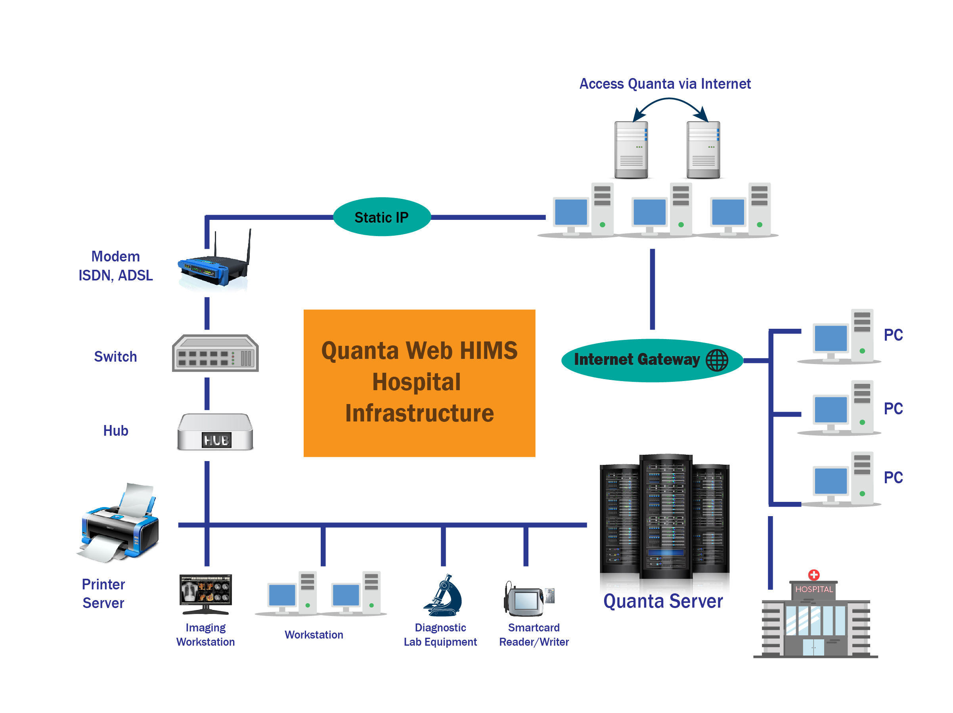
Access Quanta from Outside via Internet

Slide 33
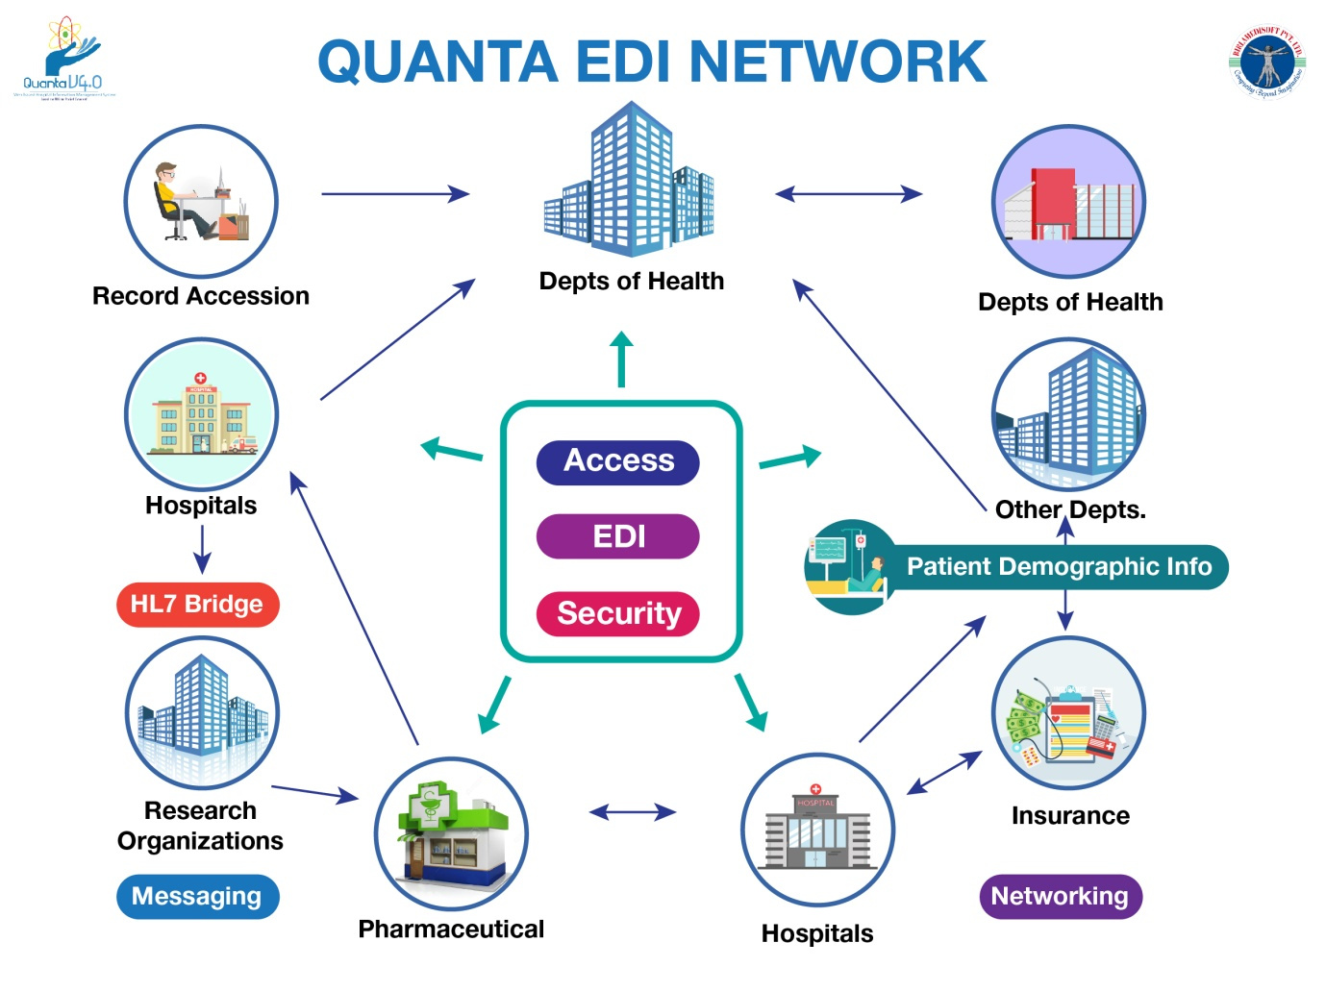

Slide 34










Interfaces/ Inputs
e-registration
Clinic
Billing
Speciality physician EHR
Health Department EHR
Community Health Center EHR
Hospital
Integrated Health
Management System
Pharmacy
HIE
Devices & PACS
e-prescription
Laboratory
HIE
Hospital EHR
Primary Care Physician EHR

Slide 35

Top Features of Quanta V4.0
User friendly design
Highly secured
Graphical Presentation of the Data for Top Management for Analysis
Interface facility with the Smart Card Technology, Interface with the Bar Code
Comprehensive Performance Reports
Complete database Driven, modular structure
Package Supports Adaptability & Scalability of Software making it more robust
Single window view to locate patient Billing, Collection, Discharge Detail, Patient Medical History, clinical notes, OT details etc.
Operate the whole software on mobile application

Slide 36






RIS
PACS
HIMS
Clinical Management
LIMS
Healthcare Solutions
Telemedicine
Specialized Modules
Pharmacy Management
Financial Costing

Slide 37

Quanta is Telemedicine Ready Solutions
Imagine you are on Beach and suddenly you need to contact your doctor, you can connect with your doctor using Quanta HIS system

Slide 38


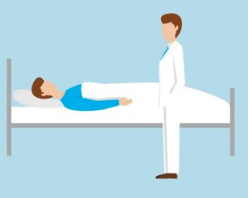


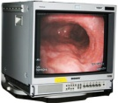



Specialty Hospital
Satellite
Rural/District Hospital
Doctor & Patient
Video Conferencing
Specialist
Consultant
doctor
Video Conferencing
Lab report
Telemedicine solutions

Slide 39
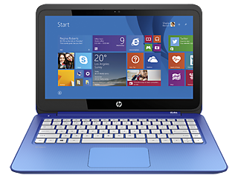
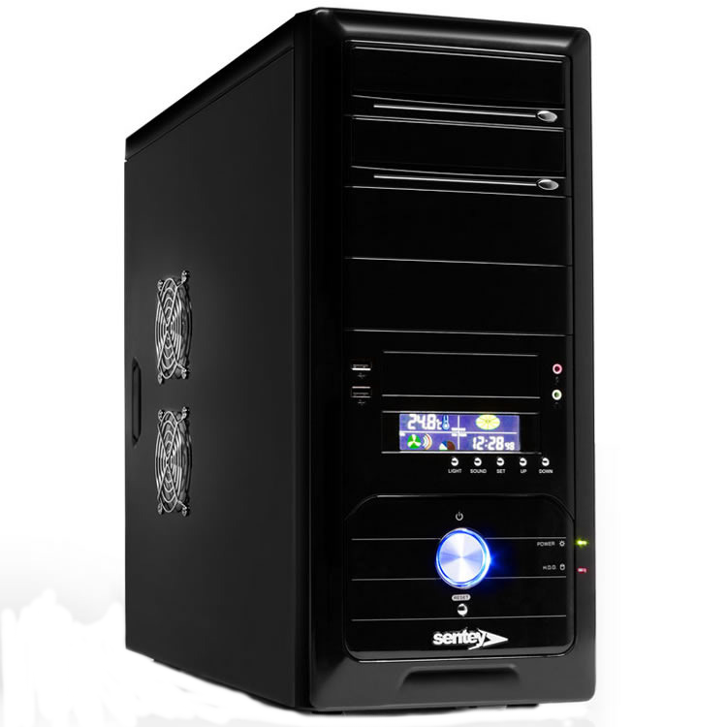

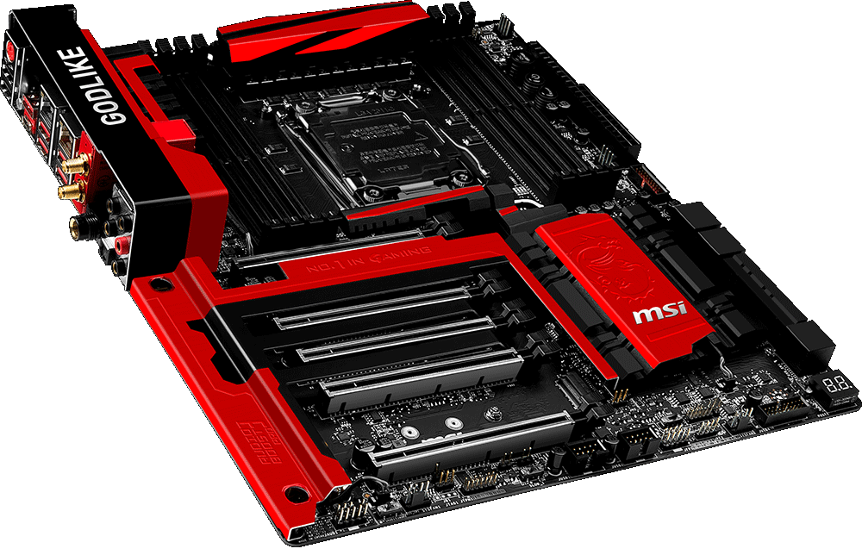
Technology Stack
User Interface & Client
Web Browsers : IE, Mozilla Firefox, Google Chrome, Safari, etc.
Operating System: Windows
Application Server
DotNET Framework, AJAX Development Toolkit, Web Services, WCF Services, IIS
Back-End (Database Server)
SQL Server / DB2 / Mongo DB
Hardware
Intel Platform, IBM Series

Slide 40

Interfaces
With Standards, our HIS is compliance with standards like
ICD-10
CPT4
HL7
ASTM
HIPAA
NABH
CAP
DICOM 3.0
It can be interfaced with ERPs like Oracle
SAP
NAVision software
SAGE
MS Dynamics NAV
Tally
and Many more
With Third Party products

Slide 41


Slide 42
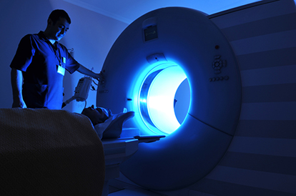

Interfaces with Medical Equipment
And also with non-DICOM equipment like pathology and imaging devices , both
uni-directional as well as bidirectional …!
It can be interfaced with DICOM equipment

Slide 43
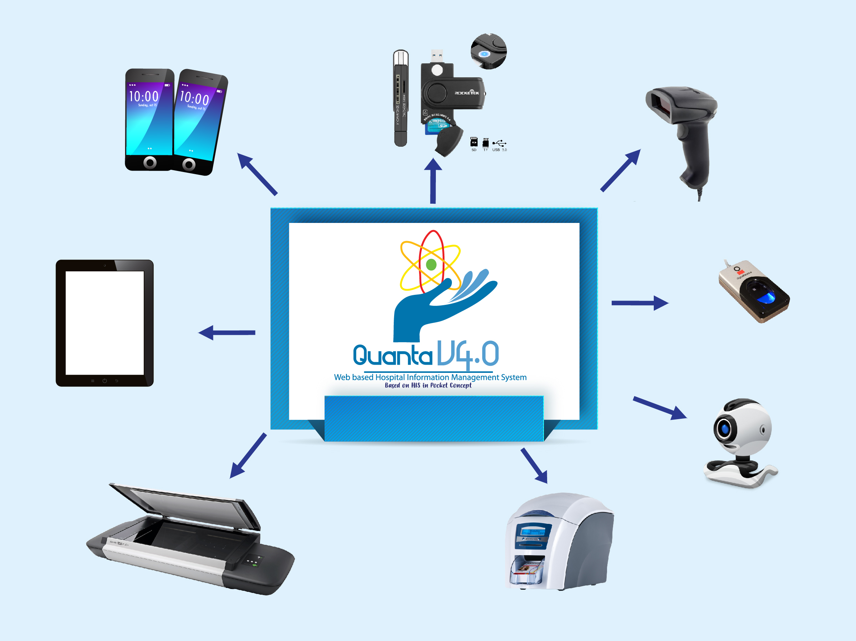
Smart Card Devices
Smart Phones
Bar Code Device
Fingerprint Authentication
Tablet
Connectivity to Gadgets
Web Camera
Scanner
Plastic Card Printer

Slide 44




Quanta – Patient Membership Actual
Card Samples
Kenyatta National Hospital, Kenya
P.O.Box. 57929-0200
0710348522
Reg. No : 150
Name : Mr. Jefferson Wambua Mule
Father Name : Mr. Mule
Age / Sex : 33 Years Male
Reg. Date : 13/03/2013
www.birlamedisoft.com

Slide 45
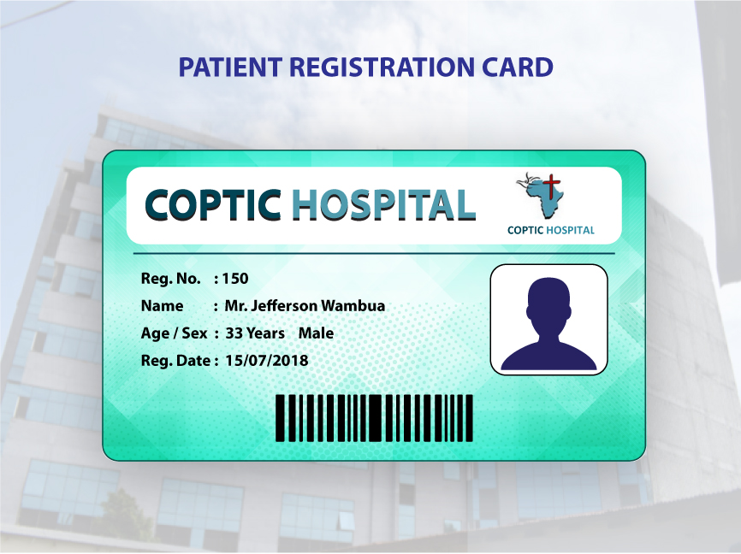

Slide 46
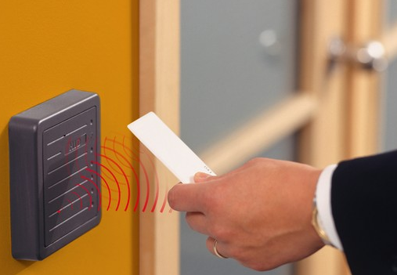
RFID DEVICES

Slide 47





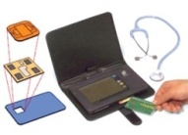









Quanta Integration for Insurance Claims Process
Start
Attendant enters claim details on HIMS
Smartlink generates confirmation file
Patient walks into Hospital & produces Smart Card
HIMS generates hospitalclaimfile.xml
HIMS checks for confirmation file
Hospital attendant runs Smart Link & places card on Reader
SP attendant runs Smart Link & places card on Reader
HIMS inserts transactions into its own Database
Attendant goes to Smartlink & selects ‘Retrieve’
Attendant selects the pool & clicks ‘Forward’ button on Database
Attendant selects the pool & clicks ‘Forward’ button on SL Dbase
Smartlink opens the claim screen with present interim claims
HIMS produces paper invoice
Data forwarded to specified location
Attendant closes/minimizes Smartlink
Attendant clicks on ‘Save claims’
HIMS reads forwarded file & populates HIMS interface
Claims inserted into Hospital Database
End

Slide 48

Screenshots

Slide 49
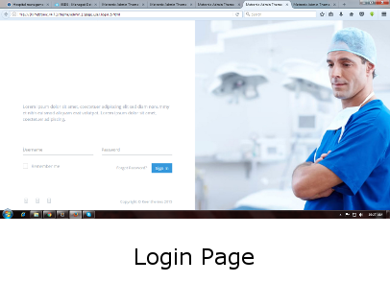
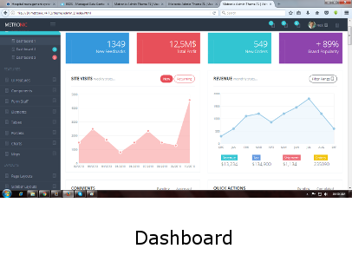

Slide 50
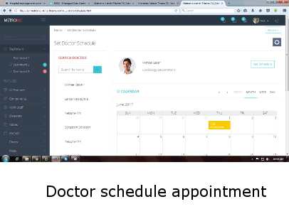
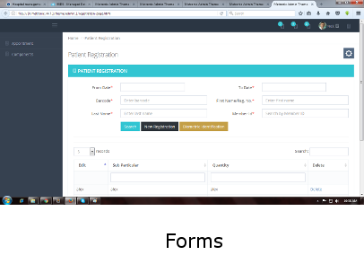

Slide 51
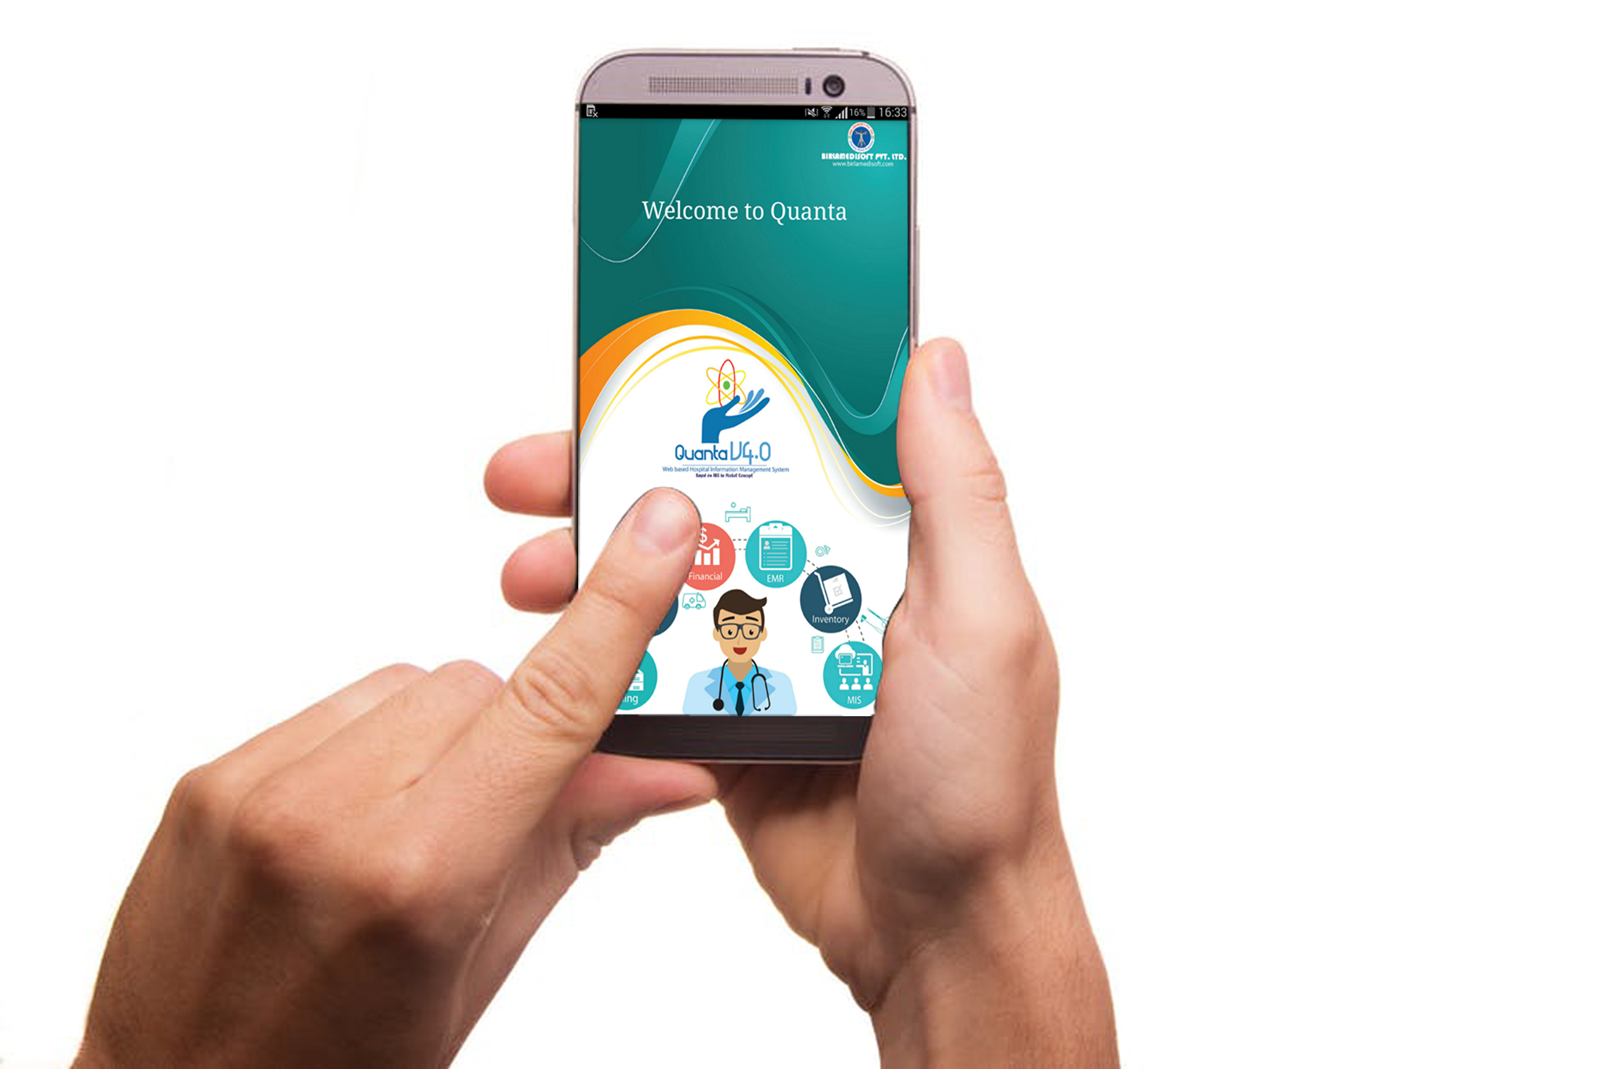
Mobile Screens

Slide 52

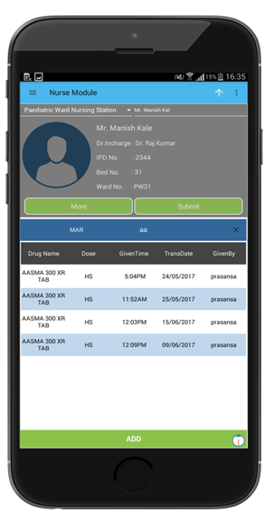
Front Page
Table View

Slide 53

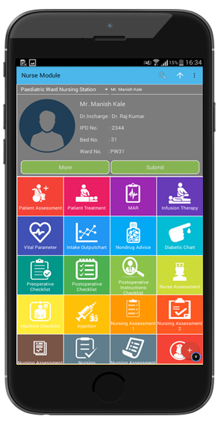
CEO Dashboard
Nurse Module

Slide 54

Clients
Dept of Health, Telangana State India, 256 UPHCs are powered by Quanta HIS
Defense Hospital Amanullah Khan Hospital in Afghanistan is powered by Quanta HIS
Dept of Health, Papua New Guinea Country are powered by Quanta HIS
All Branches of Ultratech Cement Works, In India are Powered by Quanta HIS
All Branches of Ambuja Cement Works, In India are Powered by Quanta HIS
All branches of Tata Power In India are Powered by Quanta HIS
Bhabha Atomic Research center (BARC) is using Quanta HIS system
Major Govt county Hospitals in Kenya are Powered by Quanta HIS
Al Kafeel Super Speciality Hospital, Iraq runs Quanta HIS system
Bank Of Uganda, Uganda runs Quanta HIS system
Birlamedisoft presence in 20+ countries and growing rapidly

Slide 55
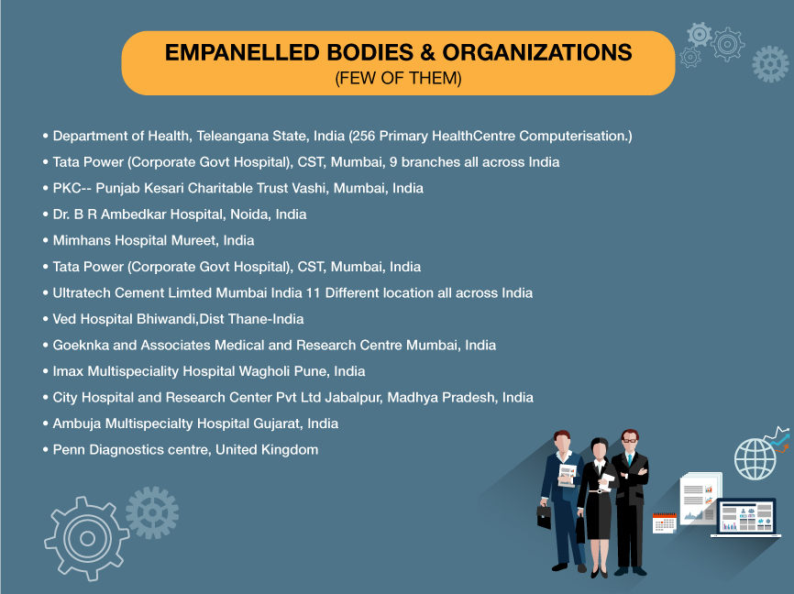

Slide 56


Slide 57



Slide 58
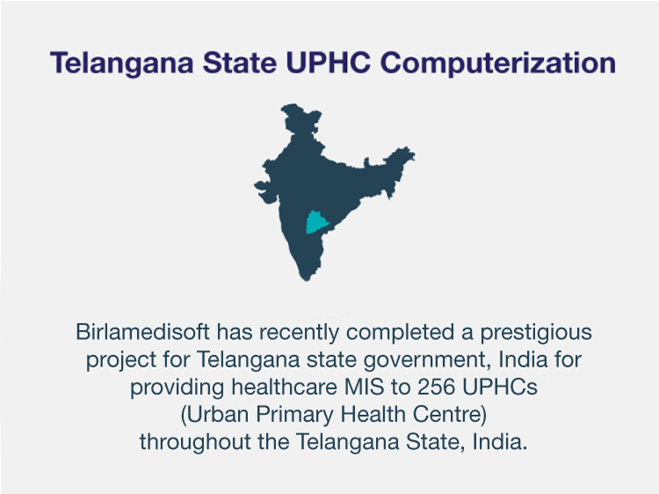

Slide 59
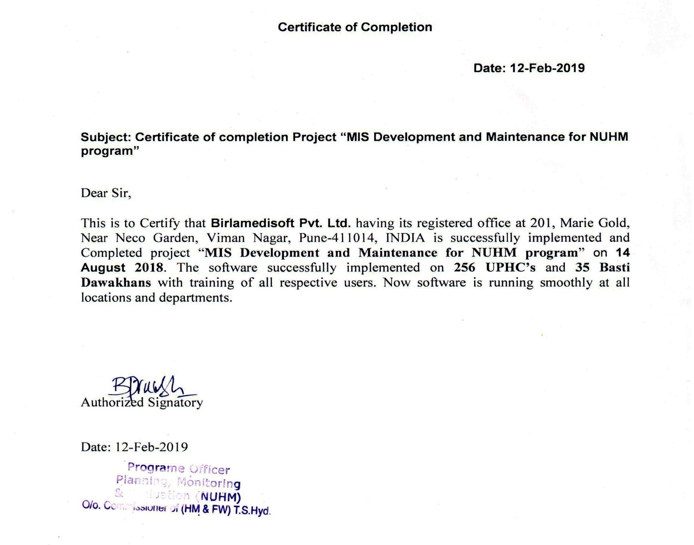
Birlamedisoft Appreciated

Slide 60
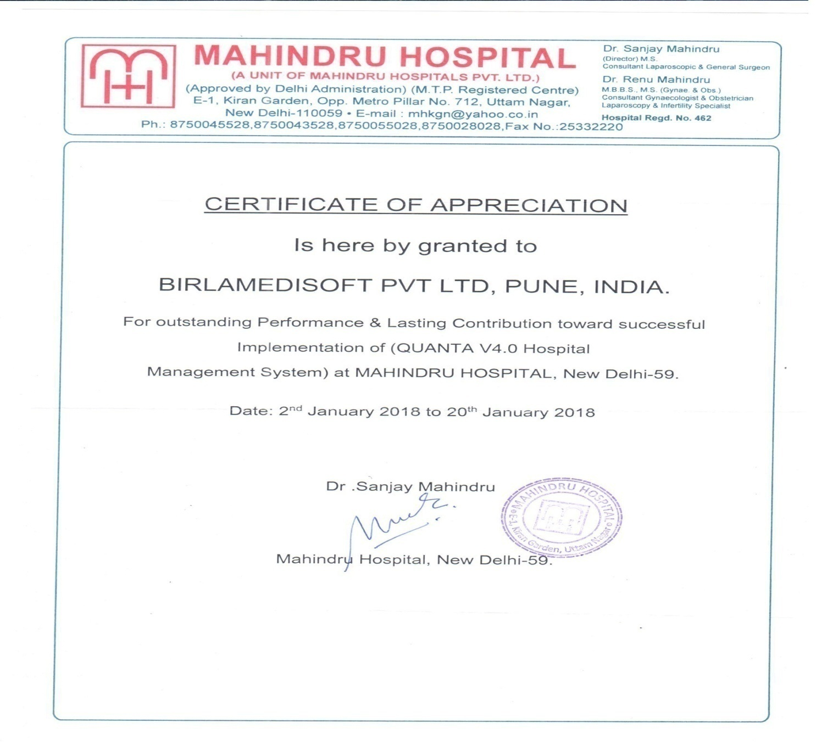
Birlamedisoft Appreciated

Slide 61
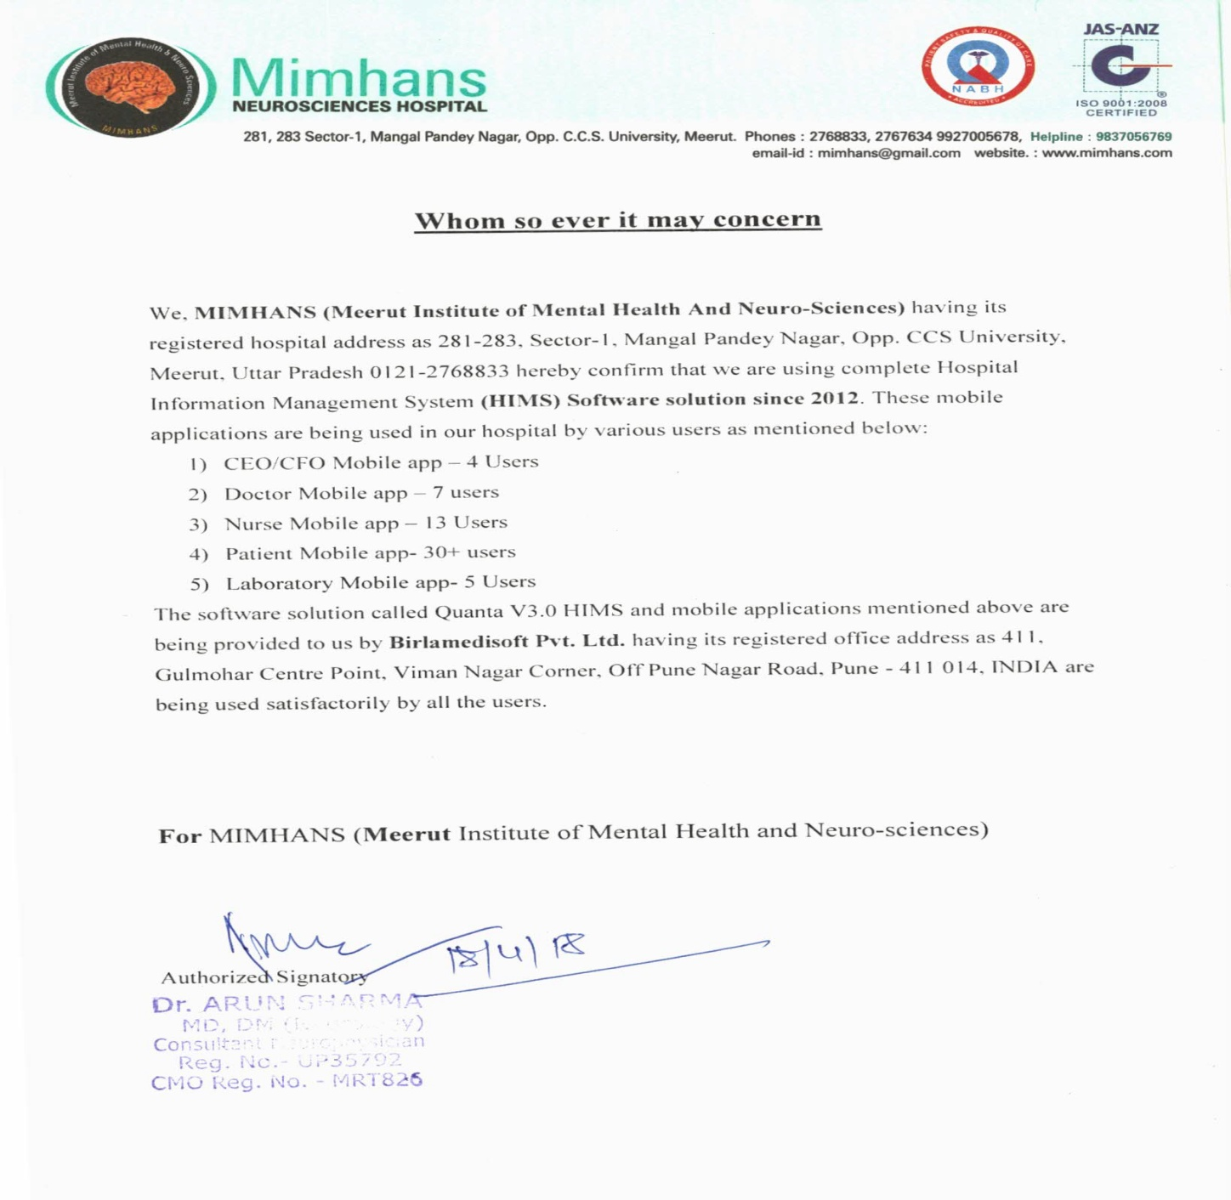
Birlamedisoft Appreciated

Slide 62

Birlamedisoft Appreciated
Hospital Management System – Quanta V4.0
The TATA Power Company

Slide 63
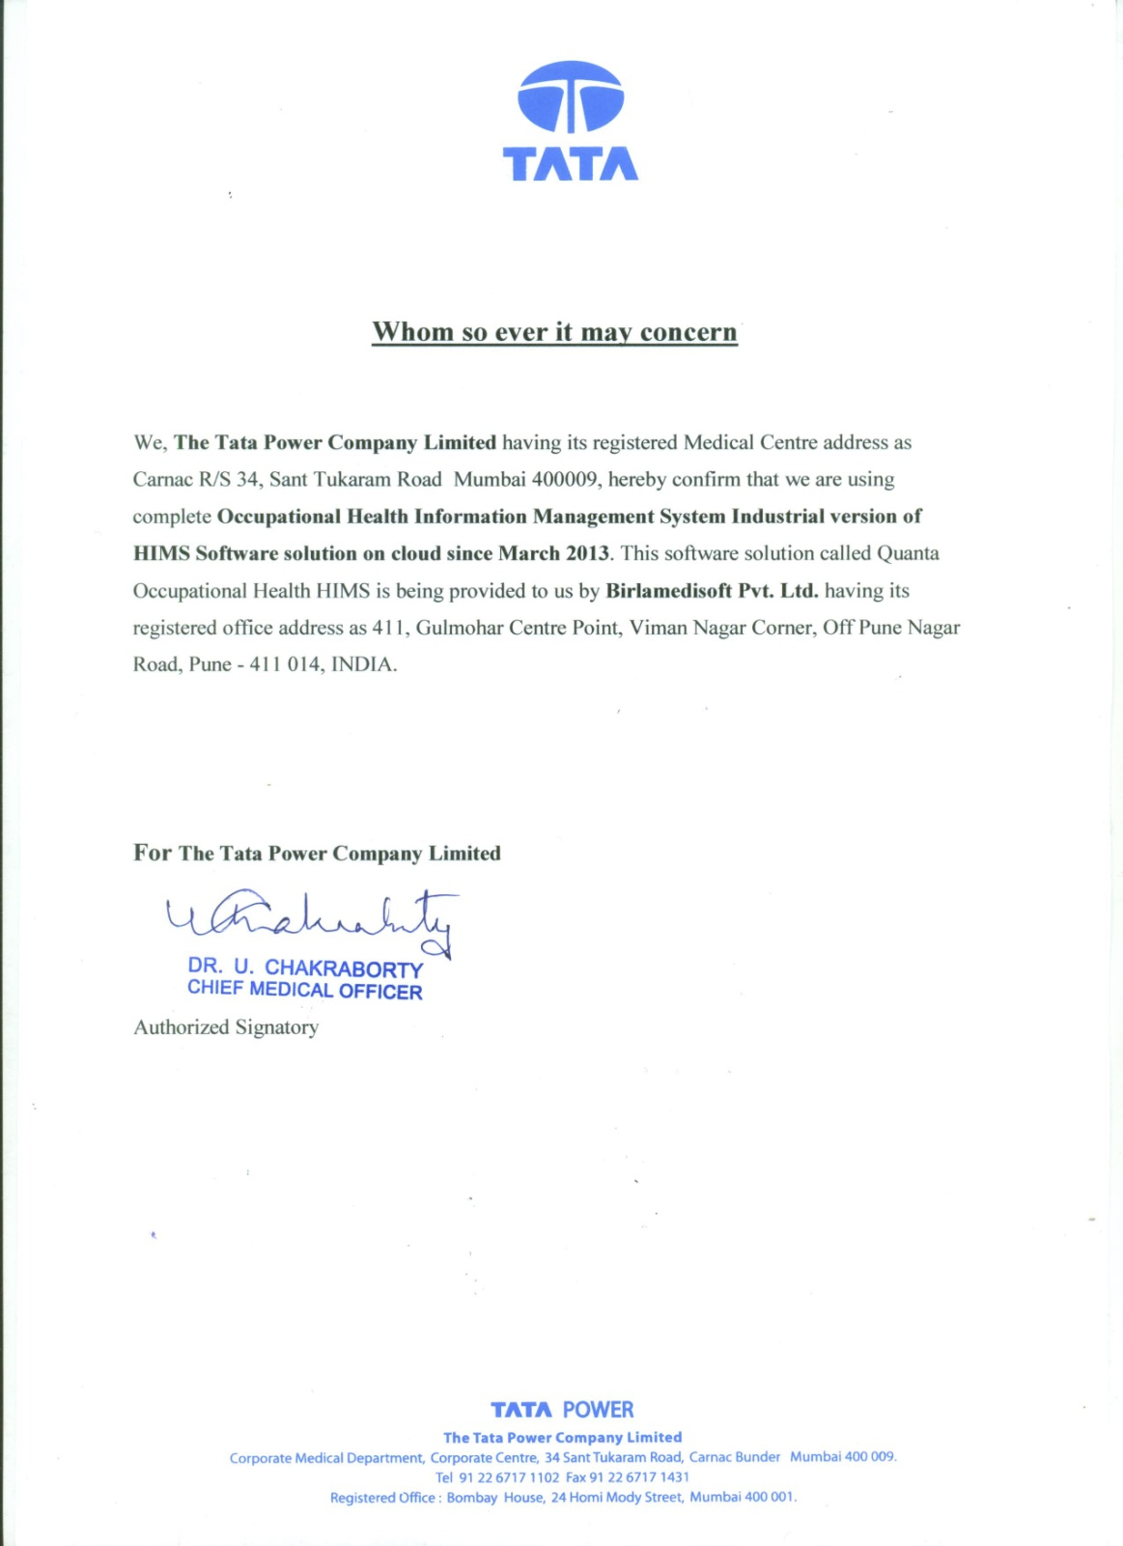
Birlamedisoft Appreciated

Slide 64
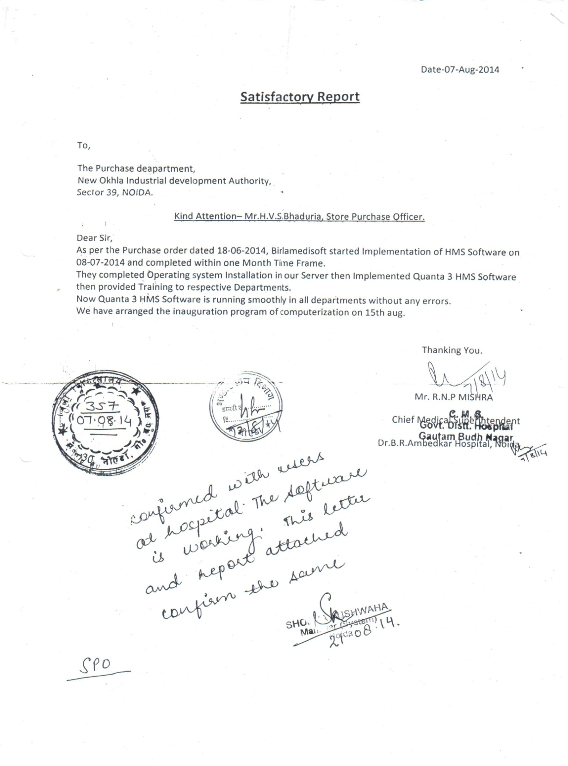
Birlamedisoft Appreciated

Slide 65
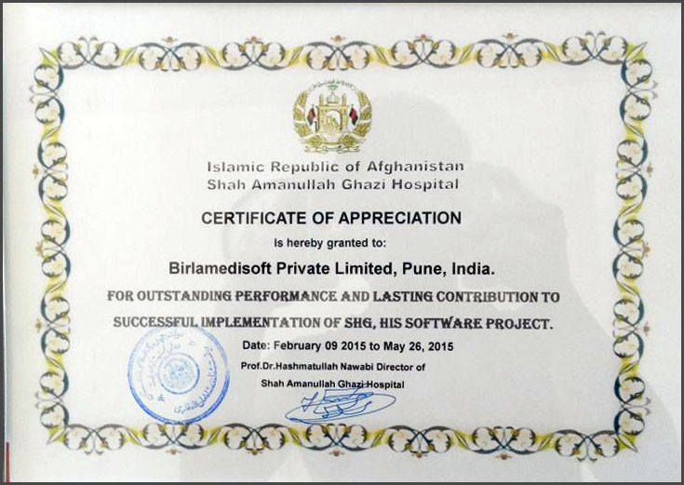
Birlamedisoft Appreciated
Hospital Management System – Quanta V4.0
NDS (Afghanistan)
www.birlamedisoft.com

Slide 66
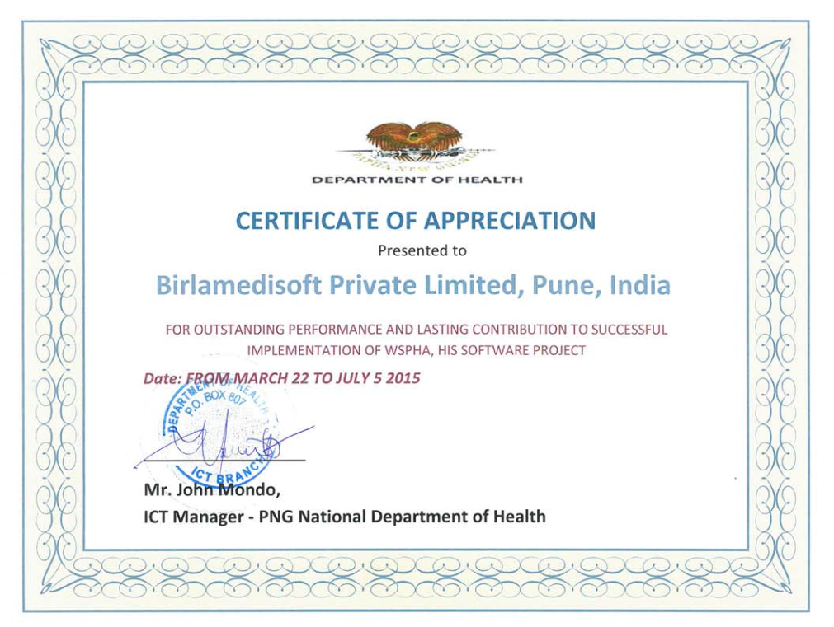
Birlamedisoft Appreciated
Hospital Management System – Quanta V4.0
PNG National Department of Health (Papua New Guinea)
www.birlamedisoft.com

Slide 67

Birlamedisoft Appreciated
Hospital Management System – Quanta V4.0
Al-Kafeel Hospital, Karbala, Iraq
www.birlamedisoft.com

Slide 68


Slide 69


